Slide 1
Genesys Contact Center Training May 2019
Reference: Genesys Documents
Upma

Slide 2

Delivery

Slide 3
Agenda - Delivery
Genesys Framework
Components Overview
Configuration Objects
GA/GAX Overview
Genesys Inbound Call Flow
Troubleshooting

Slide 4
Genesys Framework
Version: 8.5

Slide 5
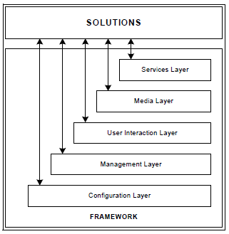
High-Level Framework Architecture
Configuration Layer processes and stores all the data required for
running Genesys solutions in a particular environment; it notifies clients of any configuration changes. The Configuration Layer also controls user access to a solution’s functions and data.
Management Layer controls the startup and status of solutions,
logging of maintenance events, generation and processing of alarms,
and management of application failures.
User Interaction Layer provides a comprehensive user interface to
configure, monitor, and control the management environment.
Media Layer enables Genesys solutions to communicate across
media, including traditional telephony systems ,Voice over IP (VOIP),
e-mail, and the Web. This layer also provides the mechanism to distribute
interaction-related business data within and across solutions.
Services Layer generates the statistical data used for interaction
processing and contact center reporting and enables solutions to
communicate with various database management systems (DBMSs).

Slide 6
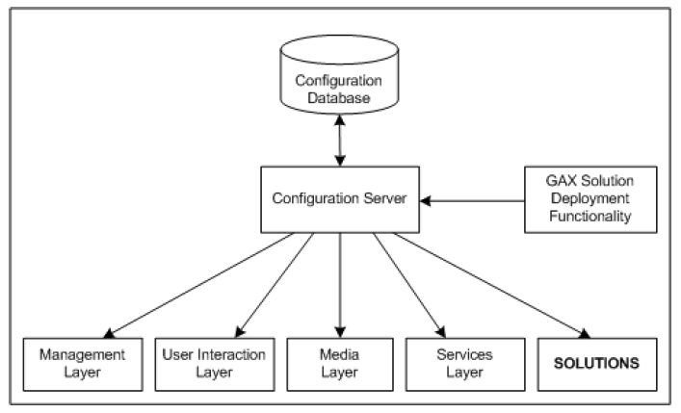
Structure of Configuration Layer
Configuration Server: Configuration Server provides centralized access to the Configuration Database, based on permissions that super administrators can set for any user to any configuration object. Configuration Server also maintains the common logical integrity of configuration data and notifies applications of changes made to the data.
Optionally, you can run Configuration Server in Proxy mode to support a geographically distributed environment.
Configuration Manager: provides a user-friendly interface for manipulating the contact center configuration data that solutions
use and for setting user permissions for solution functions & data.
Genesys Administrator, part of the User Interface Layer, provides a user-friendly interface for manipulating the contact center configuration.
Genesys Administrator Extension solution deployment functionality automates deployment and upgrade.
Configuration Database stores all configuration data.

Slide 7
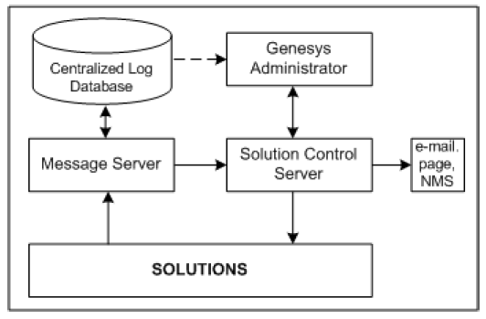
Structure of Management Layer
Solution Control Server is the processing center of the Management Layer. It uses Local Control Agents to start solution components in the proper order, monitor their status, and provide a restart or switchover in case of application failure.
Local Control Agent (not shown in the diagram), located on every host that the Management Layer controls and/or monitors, is used to start and stop applications, detect application failures.
Message Server provides centralized processing and storage of every application's maintenance events.
Centralized Log Database (also called the Log Database) stores all application log records, including interaction related records, alarm history records.
Genesys Administrator, a User Interaction Layer component, displays the status of all installed Genesys solutions and information about each active alarm, enables the user to start and stop solutions or single applications.

Slide 8
What is Local Control Agent
LCA is a daemon process
LCA cannot be started via Management Layer
Starts, stops and monitors applications configured in the GA
Detects failures of the applications that are monitored
Communicates the roles of the monitored applications in the redundancy context
If applications are started via Management Layer LCA is the Parent process for them
Monitors applications-performance-related statistics
Host 1
LCA
Applications

Slide 9
What is Solution Control Server
Core application of the Management Layer
Monitors statuses of the applications
Sets correct statuses to the applications
Provides restart or switchover in case of application failure
Processes user-specified Alarms
Host 1
LCA
SCS
Applications
Host N
LCA
Applications

Slide 10
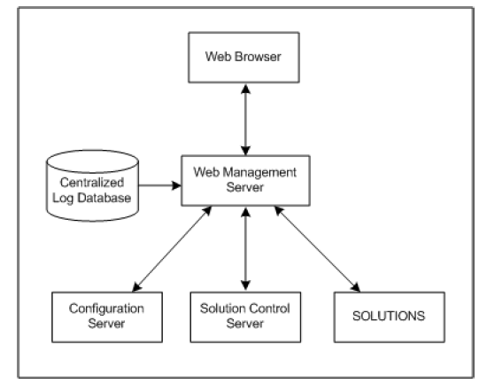
User Interaction Layer
The browser-based Genesys Administrator includes a comprehensive user interface to configure, monitor, and control the management environment.
The Web Management Server:
Communicates with Configuration Server (a Configuration Layer component) to exchange configuration information.
Communicates with Solution Control Server (a Management Layer component) to exchange status, operations and control information.
Reads logs from the Centralized Log Database (a Management Layer component).

Slide 11
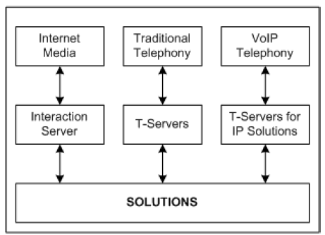
Media Layer
The Media Layer provides:
Interfaces to communication media.
Distribution of interaction-related business data within and across solutions.
SIP Server is the Genesys software component that provides an interface between your telephony hardware and the rest of the Genesys software components in your enterprise.
It translates and keeps track of events and
requests that come from, and are sent to the telephony device.

Slide 12
SIP Server in the Contact Center environment
SIP Server consists of T-Server Common part and a call-switching component, in which the call-switching element functions as a SIP (Session Initiation Protocol) Back-to-Back User Agent (B2BUA).
SIP Server provides both SIP signaling and T-Server functions.
Customer network connecting external network
GENESYS SUITE
iWS / GAD /
3rd party desktop client
URS
Stat Server
T-lib
Management
Framework
T-lib
T-lib
SIP Server
T-lib
Media Gateway
RM / MCP
T-lib
SBC
SIP
SIP/SDP
SIP
SIP End point
SIP
SIP
RTP or voice traffic
RTP or voice traffic
Part of call will be T-lib request/response/events, SIP signaling and Voice traffic

Slide 13
SIP and associated VoIP Protocols
SIP:
The Session Initiation Protocol (SIP) is a signaling communications protocol, widely used for controlling multimedia communication sessions such as voice and video calls over Internet Protocol (IP) networks.
The protocol defines the messages that are sent between endpoints, which govern establishment, termination and other essential elements of a call.
SDP:
The Session Description Protocol (SDP) is a format for describing streaming media initialization parameters. SDP does not deliver media itself but is used for negotiation between end points of media type, format, and all associated properties.
RTP:
The Real-time Transport Protocol (RTP), defines a standardized packet format for delivering audio and video over IP networks.
RTP is one of the technical foundations of Voice over IP and in this context is often used in conjunction with a signaling protocol such as the Session Initiation Protocol (SIP) which assists in setting up connections across the network.

Slide 14
SIP Message
SIP message consists of SIP session info and may contain SDP providing RTP details:
Request
INVITE sip:9001@192.168.0.3:5080 SIP/2.0
Via: SIP/2.0/UDP 192.168.0.3:15544;branch=z9hG4bK-d8754z-3cccbc7dd34c4670-1---d8754z-;rport
Max-Forwards: 70
Contact: <sip:9819276249@192.168.0.3:15544>
To: "9001"<sip:9001@192.168.0.3:5080>
From: <sip:9819276249@192.168.0.3:5080>;tag=e7460900
Call-ID: MTZhMDZlZjg4ZjU1NDFhNDA3NmRjZTJhZTc3MjY3OTg
CSeq: 1 INVITE
Allow: INVITE, ACK, CANCEL, OPTIONS, BYE, REFER, NOTIFY, MESSAGE, SUBSCRIBE, INFO
Content-Type: application/sdp
Supported: replaces
User-Agent: X-Lite release 4.5.5.1 stamp 74226
Content-Length: 302
v=0
o=- 13056663890031250 1 IN IP4 192.168.0.3
s=X-Lite 4 release 4.5.5.1 stamp 74226
c=IN IP4 192.168.0.3
t=0 0
m=audio 5082 RTP/AVP 125 9 8 0 100 101
a=rtpmap:125 opus/48000/2
a=fmtp:125 useinbandfec=1
a=rtpmap:100 speex/16000
a=rtpmap:101 telephone-event/8000
a=fmtp:101 0-15
a=sendrecv
SIP dialog
SIP
SIP Headers
A SIP dialog is identified by a Call-ID, a local tag and a remote tag.
Call-ID: MTZhMDZlZjg4ZjU1NDFhNDA3NmRjZTJhZTc3MjY3OTg
local tag (tag in From header) = e7460900
Remote tag = will appear upon receiving response from other sip device (it will be added in To header)
SDP
RTP, IP Port and supported Codecs
RTP IP - 192.168.0.3, Port – 5082
Codecs offered – 125, 9, 8, 0, 100, 101

Slide 15
SIP based VoIP Call between two SIP end points with SIP Server
.
Genesys
SIP Server
UA 1
UA 2
INVITE with SDP OFFER
B2BUA
TL
IB
P
ART
SIP dialog 1
100 Trying
SIP dialog 1
SIP dialog 2
INVITE with SDP OFFER
180 Ringing
180 Ringing
SIP dialog 2
SIP dialog 1
SIP dialog 2
200 OK with SDP ANSWER
200 OK with SDP ANSWER
SIP dialog 1
ACK
SIP dialog 1
SIP dialog 2
ACK
RTP or Voice Traffic
BYE
SIP dialog 1
BYE
200 OK
SIP dialog 2
SIP dialog 1
SIP dialog 2
200 OK

Slide 16
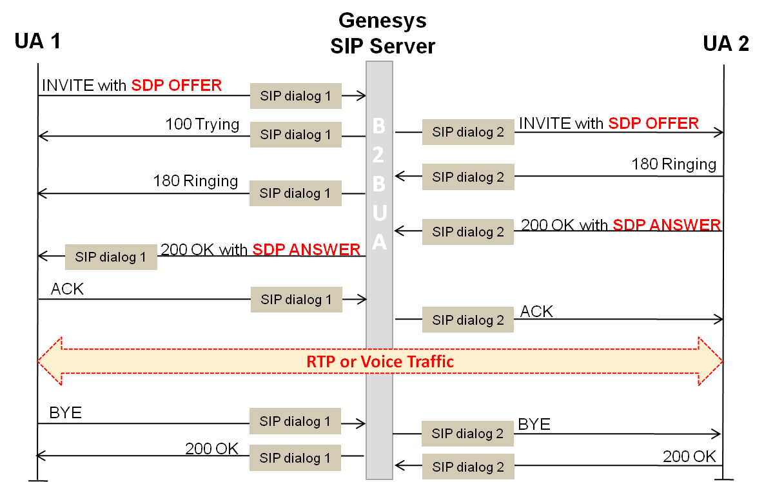
T-Lib Clients will be notified with call progress events
Genesys
SIP Server
B2BUA
TL
IB
P
ART
EventRinging
EventOffHook
EventEstablished
EventReleased
T-lib client (such as URS/Stat Server/OCS/iWS etc)

Slide 17
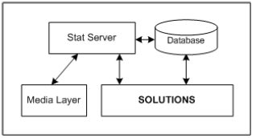
Service Layer
Stat Server tracks real-time states of interaction management resources and collects statistics about contact center performance.
Genesys solutions use the statistical data to more intelligently manage real-time interactions.
Through Genesys Reporting, you can use the data to generate real-time and historical contact center reports.
Real- Time Reporting: Genesys Pulse is used for real time measurement of calls in the contact center. It provides an insight into what is happening in terms of telephony activity within the team and down to individual levels. It also provides statistics on the total number of calls handled and abandoned, status information and summary information.
Historical Reporting: To visualize the performance of your contact center over time using Genesys Interactive Insights(GI2).GI2 uses the data that is stored in Genesys Infomart database and presents the data in readable reports to enable business and contact center managers to make better business decisions.

Slide 18
Configuration Objects
Extension DN
Place
Person
Agent Group
Virtual Queue
DN Group
Trunk DN
Routing Point DN
Default RP DN
Enhanced Routing Script
VOIP DN

Slide 19
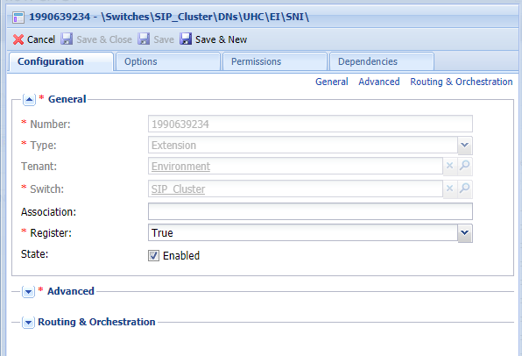
Extension DN
Extension represent agent phone extensions and register directly with the SIP Server.
Type: Extensions used for endpoint configuration
Number: Any valid integer value
State must be Enabled so SIP Server utilizes the DN
Section name “TServer” under annex tab must be created. This section is used to define endpoint configuration options that are SIP specific.

Slide 20
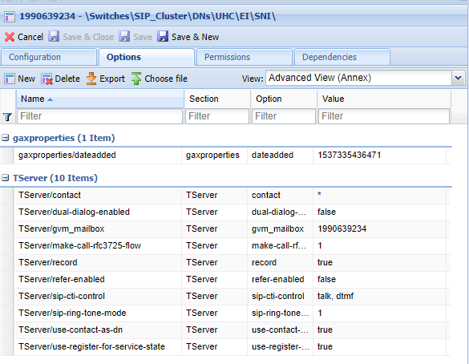
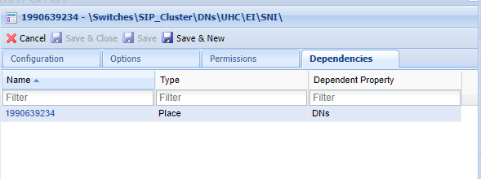
Extension DN

Slide 21
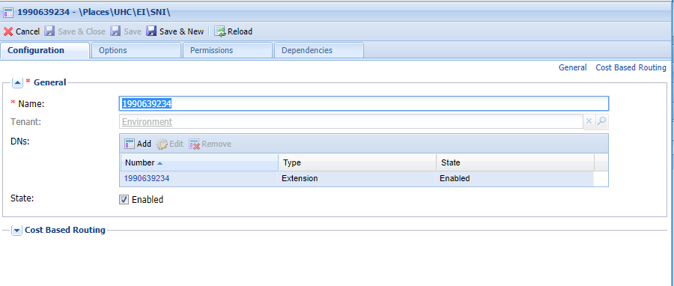
Place
An object, representing a location, that has one or more Directory Number (DNs) that are operated by a single agent.

Slide 22
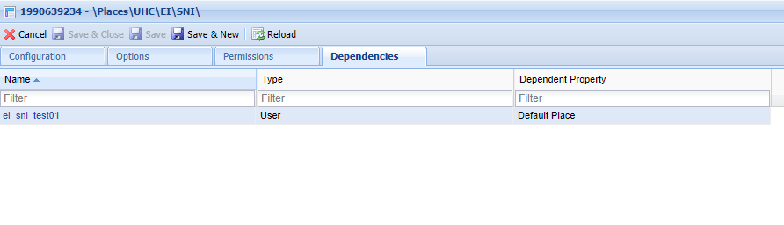
Place

Slide 23
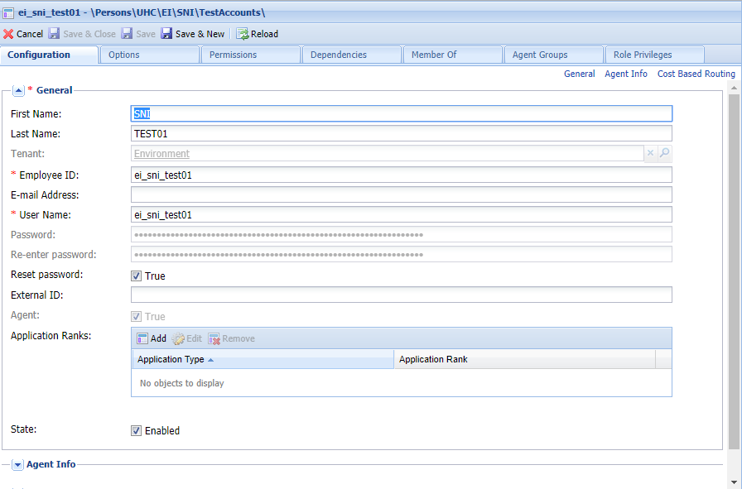
Person/User
Persons (or users) are the contact-center personnel, including agents, who need access to Genesys applications. Agents are users who handle customer interactions directly. Non-agent users include managers and supervisors.

Slide 24
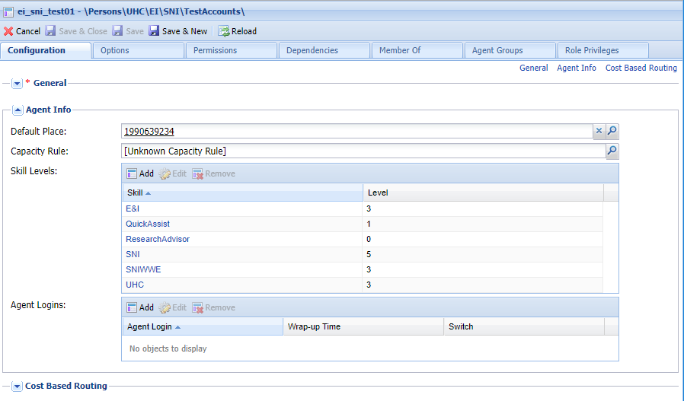
Person/User

Slide 25
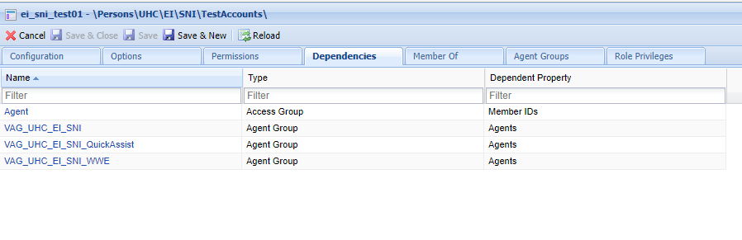
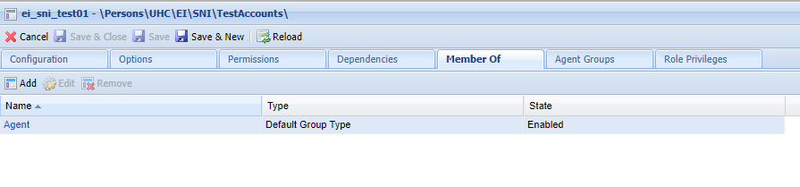
Person/User

Slide 26
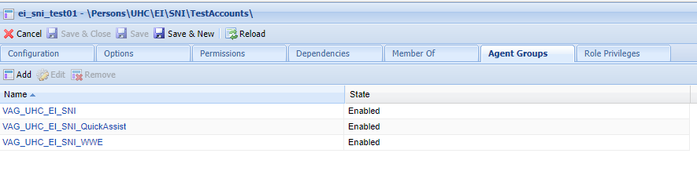
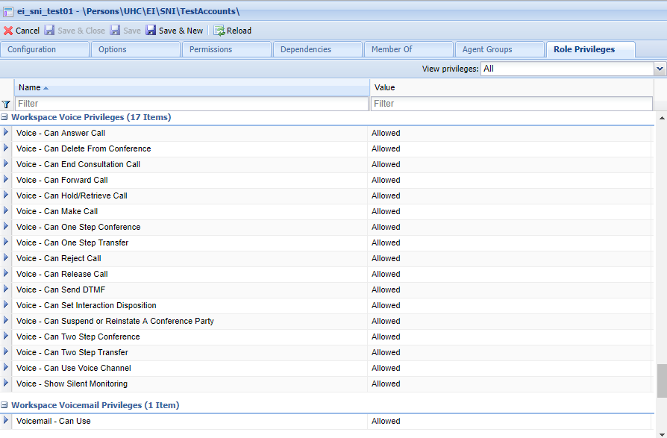
Person/User

Slide 27
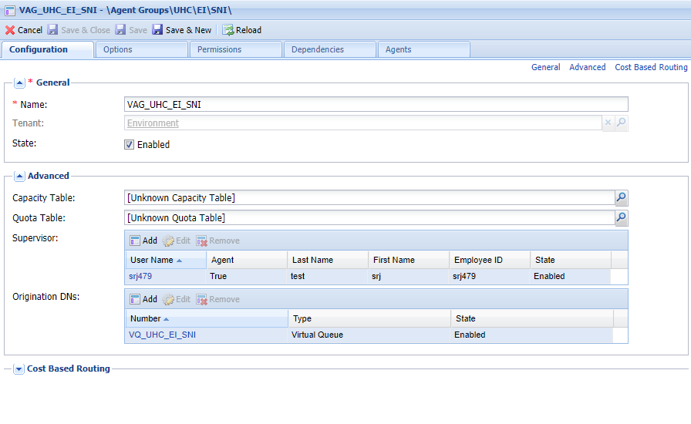
Agent Group
An Agent Group is a logical grouping of Agents. Agent Groups are typically set up to provide particular sets of contact-center services.
A Virtual Agent Group is similar to an Agent Group except that a Virtual Agent Group has no permanent members. Instead, an Agent becomes a member of a Virtual Agent Group if that Agent meets the criteria specified by the script. Agent membership in a Virtual Agent Group can change dynamically based on changes in the Virtual Agent Group criteria or changes in the object properties of the Agent.
Virtual Agent Groups are used primarily by Reporting applications.

Slide 28
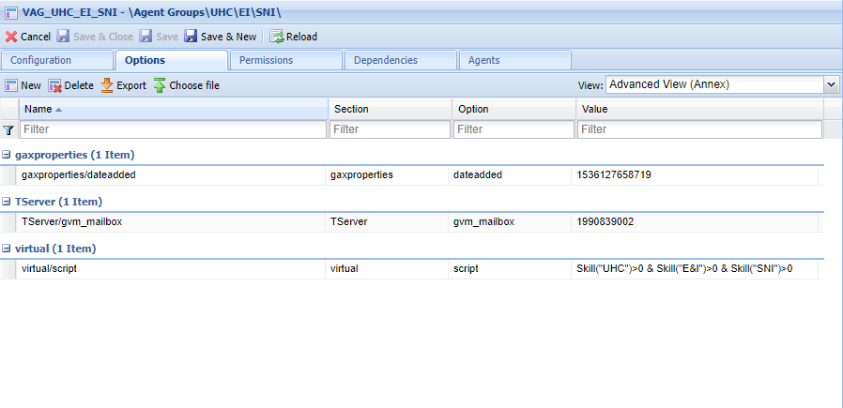
Agent Group

Slide 29
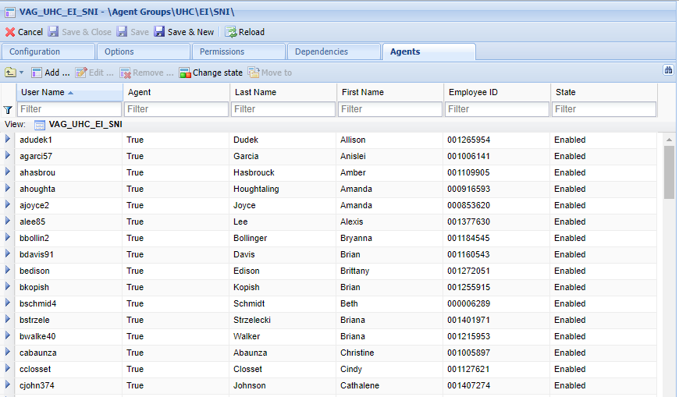
Agent Group

Slide 30
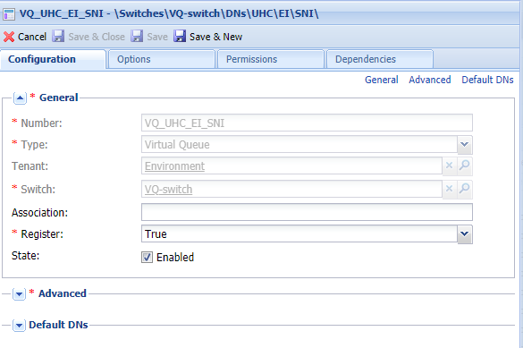
Virtual Queue
Virtual Queue is a logical queue where an interaction is queued if the target is not available.
VQs can be associated with any target type like agent, agent group, place and place groups and commonly used for reporting purposes.

Slide 31
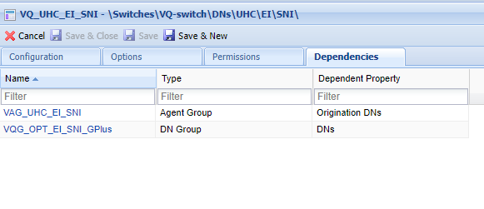
Virtual Queue

Slide 32
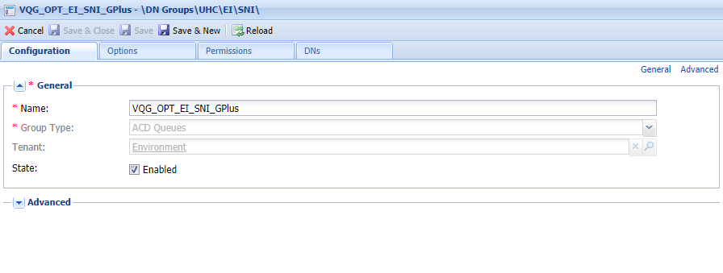
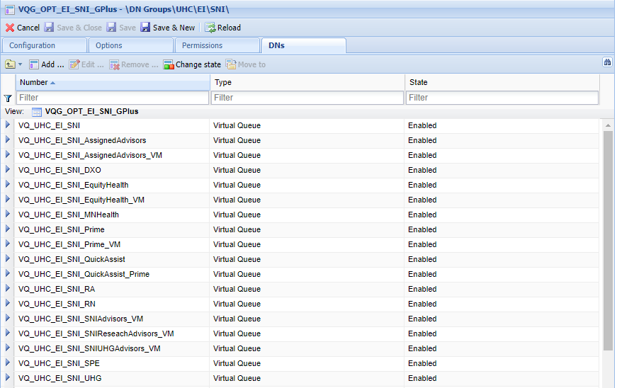
DN Group
DN Groups are logical groupings of DNs. Stat Server can monitor group od DNs using DN group or group of agents using agent group . This DN group can be selected when creating a CC Pulse view.

Slide 33
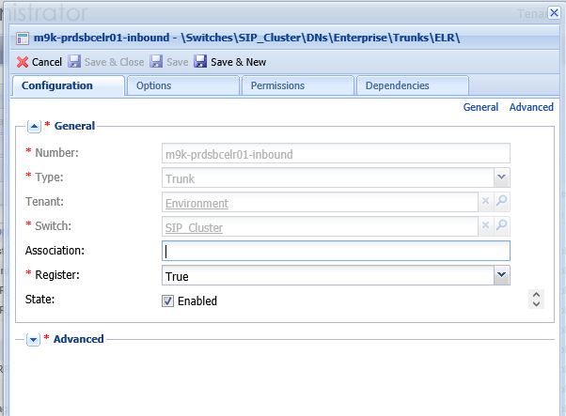
Trunk DN
Customer connected via MGW or SBC or 3rd party IP PBX – represented in GA as Trunk DN

Slide 34
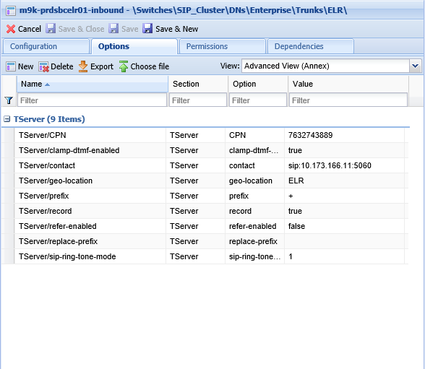
Trunk DN

Slide 35
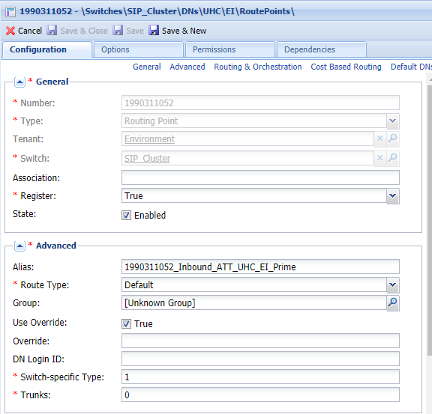
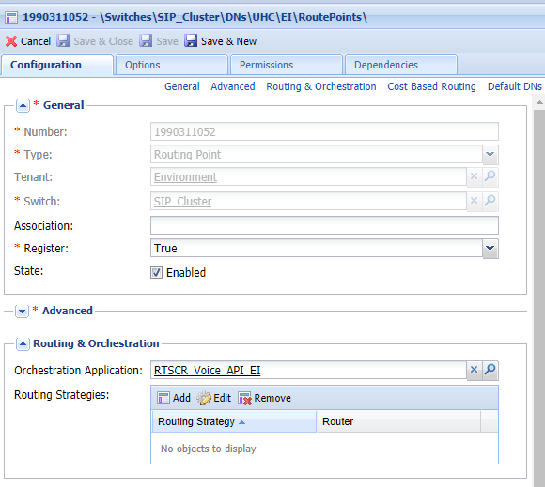
Routing Point DN
Also known as RP. Any point at which interactions wait for routing by Universal Routing Server(URS).It has associated script with them and directs calls to a destination.

Slide 36
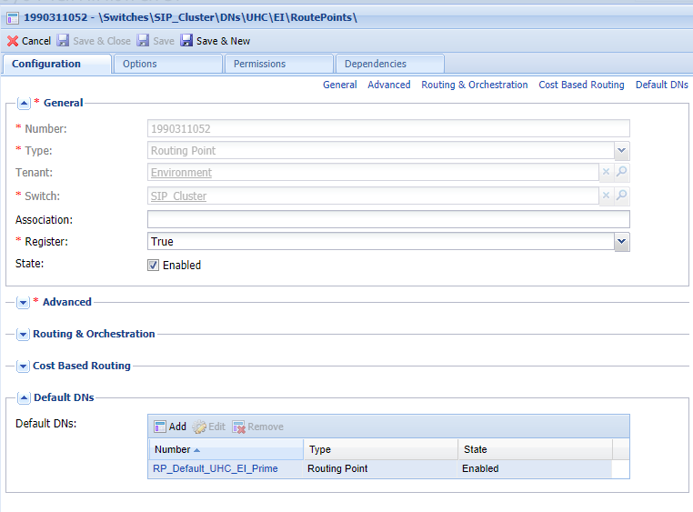
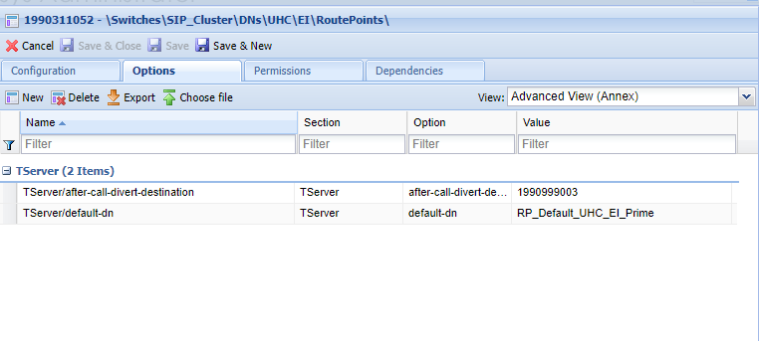
Routing Point DN

Slide 37
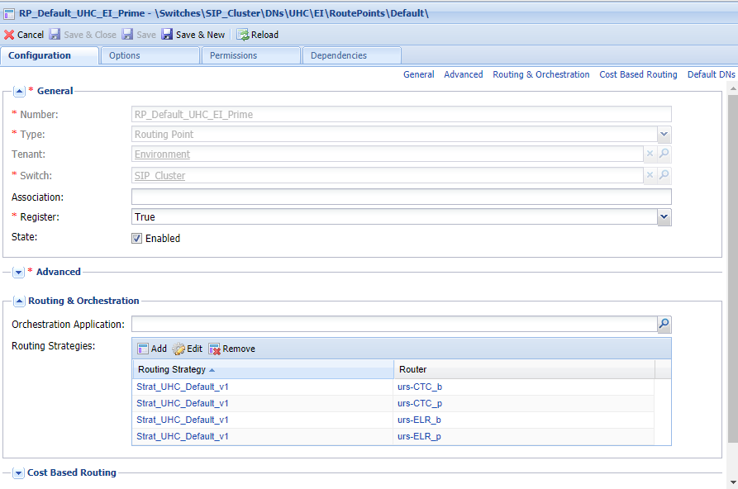
Default RP DN

Slide 38
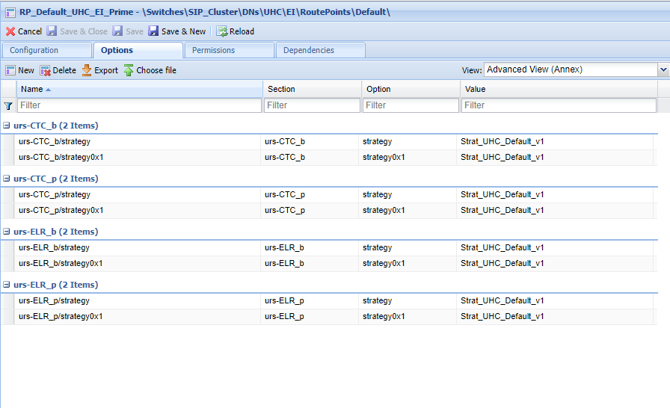
Default RP DN

Slide 39
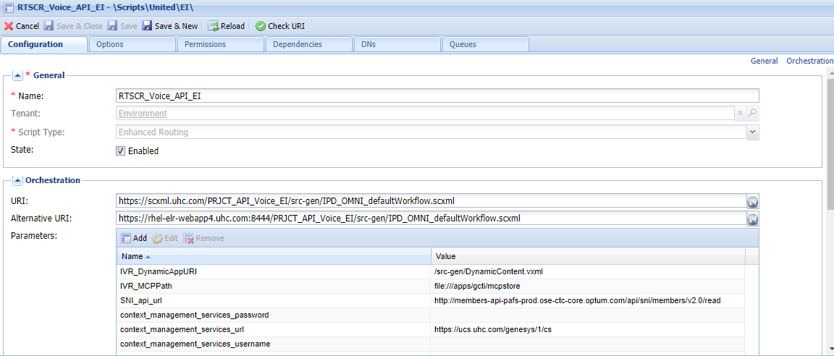
Enhanced Routing Script

Slide 40
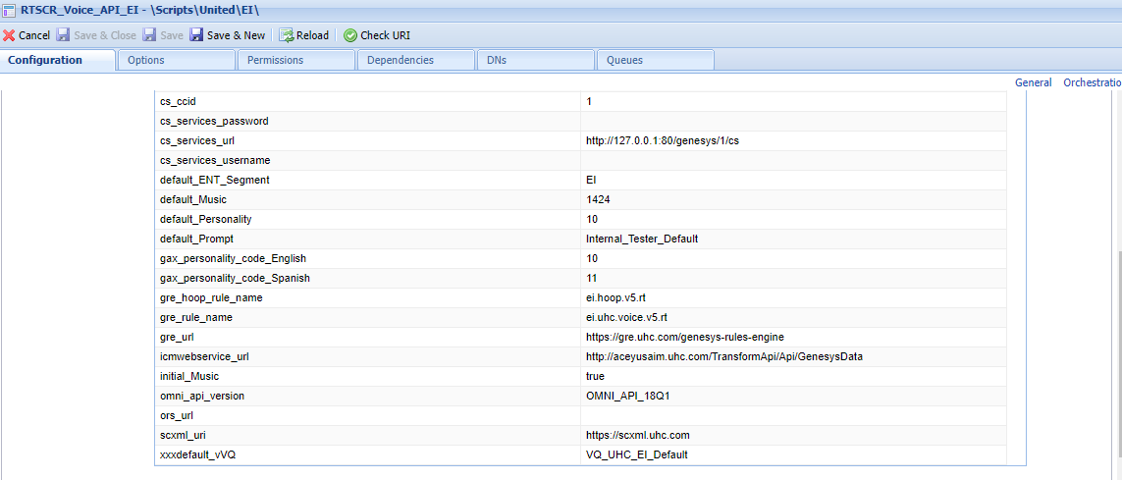
Enhanced Routing Script

Slide 41
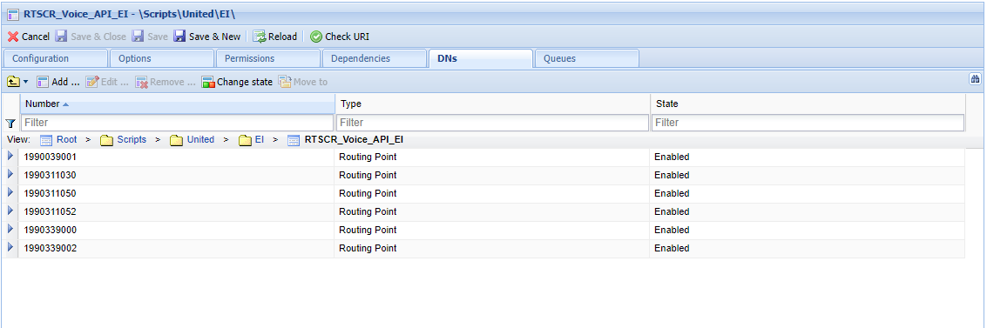
Enhanced Routing Script

Slide 42
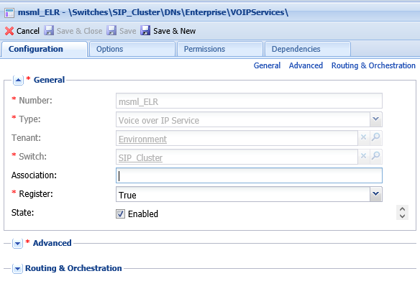
VOIP DN
Genesys Media Server providing media services– represented in GA as MSML VOIP DN

Slide 43
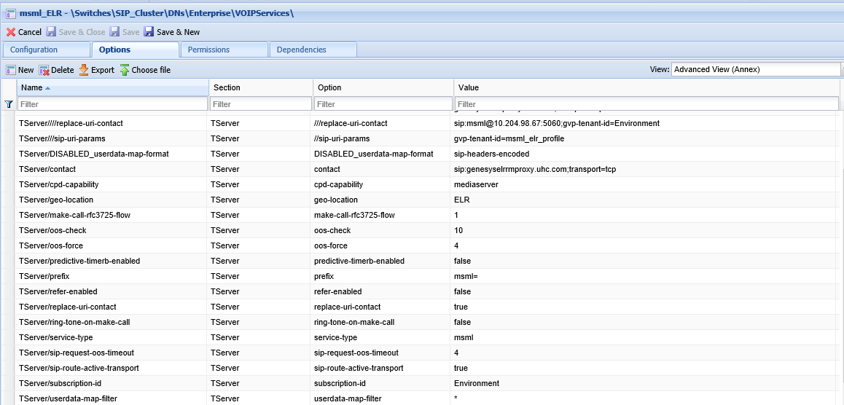
VOIP DN

Slide 44
Q & A
Thank You!
To Be Continued…. ☺

